Slide 1
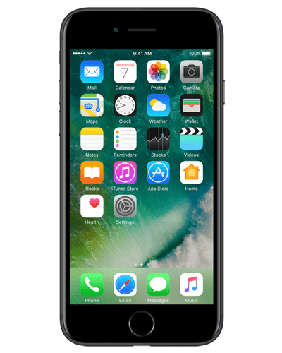
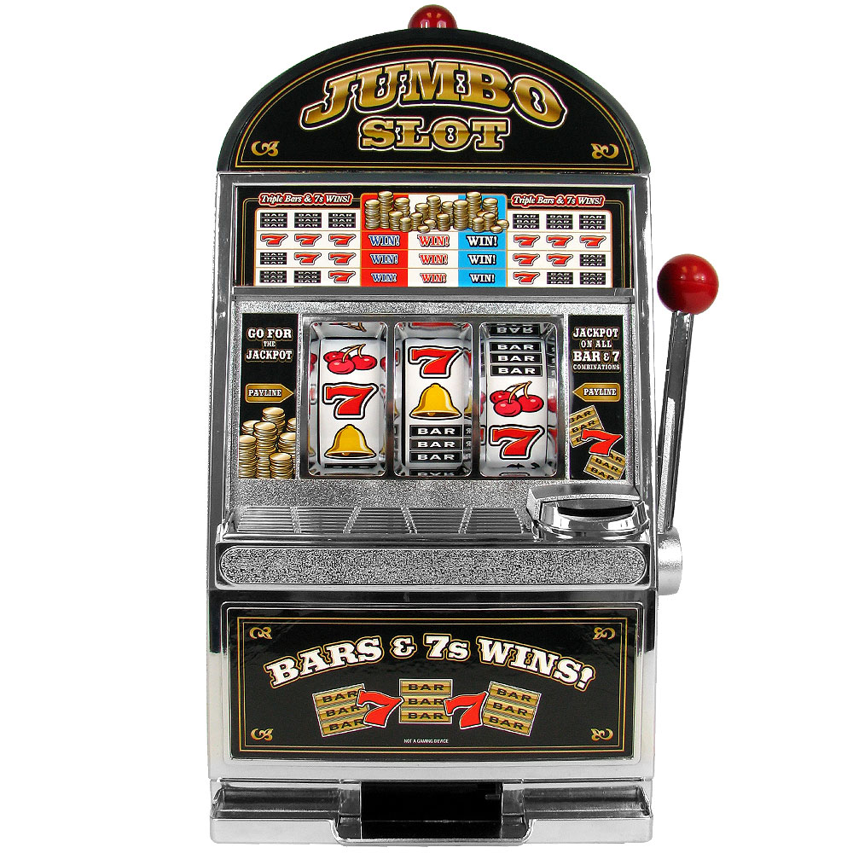
=

Slide 2
Social Media Apps

Slide 3
Use the apps
Exciting rewards
Want more rewards

Slide 4
